Slide 1
Goals
Implement a programmable data plane for New IP packet processing
Address customization: applications and routers should be able to forward packets between hosts with different address formats.
Design an end-to-end model to meet service delivery guarantees: routers should be able to process various in-network New IP contracts as described by the applications.
Rapid experimentation of the New IP components should be possible.
Notes:
Change font

Slide 2
IP packet flow in Linux

Slide 3
Main Components
Topology setup - Network Stack Tester (NeST)
Scapy - Host side API
eXpress Data Path XDP - shipping and contract processing
Traffic Control-BPF (TC) - LBF queue discipline

Slide 4
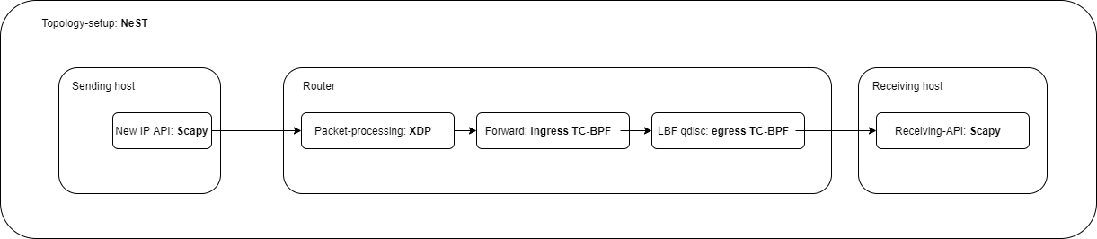
New IP packet flow

Slide 5
Topology setup: NeST
NeST is a python3 package designed for emulating real-world networks
Uses Network namespaces to create the topology
Makes testing easier
For this project, NeST is used to:
Assign IP addresses to the nodes
Populate the routing tables
Form the packet by providing necessary information like MAC addresses
Notes:
Replace for newIP with statement in next slides

Slide 6
Host side API: Scapy
Python library for powerful interactive packet manipulation
Helps forming custom packet formats
Uses Raw sockets internally
For this project, Scapy is used to:
Craft and send the packets from the virtual interface setup by NeST
Sniff and decode the packet at the receiver

Slide 7
XDP
XDP is an eBPF based high performance data path
Merged in the Linux kernel
Provides packet processing at the lowest point in the software stack
For this project, XDP is used to:
Update the Ethernet header in the packet
Identify the interface from which the packet is to be sent using kernel routing tables or BPF maps
Store the exit interface index (ifindex) in metadata of the packet
Pass the packet on to the TC BPF hook

Slide 8
TC-BPF
BPF programs attached to the traffic control (tc) ingress and egress hook
Runs after the networking stack has done the initial processing of the packet
Has access to the metadata of the packet
For this project, TC-BPF is used to:
Add our queueing discipline (we cannot have queue discipline with just XDP)
Read the ifindex from metadata at ingress hook
Redirect the packet to the egress hook of the interface associated with ifindex
Run our queue discipline on the egress hook

Slide 9
Latency Based Forwarding (LBF)
Delivers packets within bounded latency (both minimum and maximum)
Uses number of hops to determine how much time the packet should wait at a node
Experienced delay stored in the packet so no need of clock synchronization
LBF contract packet includes Minimum delay, Maximum delay, experienced delay, fib_todelay, fib_tohops
Users provide Minimum and Maximum delay
Implemented as Linux Kernel module
Can be loaded using TC

Slide 10
Principles
Ideally, the packet should spend number of hops/minimum delay (fib_tohops/min_delay) at each hop
Time to be spent at each hop = (minimum delay - delay experienced)/number of hops left
If experienced delay greater than maximum delay then drop the packet
Packet is dropped if the number of hops exceed the expected number of hops

Slide 11
Example 1
4 nodes (h1— r1 — r2 — h2)
number of hops = 3
minimum delay = 300ms
no queueing delay
At node h1: packet delayed by LBF = (minimum delay - experienced delay)/number of hops = (300 - 0) / 3 = 100ms
At node r1: (300 - 100) / 2 = 100ms
At node r2: (300 - 200) / 1 = 100ms

Slide 12
Example 2
4 nodes (h1— r1 — r2 — h2)
number of hops = 3
minimum delay = 300ms
Queueing delay = 50ms at every queue
At node h1: packet delayed by LBF = (minimum delay - experienced delay)/number of hops = (300 - 50) / 3 = 83ms
At node r1: (300 - (83 + 50 +50)) / 2 = 58.5ms
At node r2: (300 - (83.5 + 50 + 50 + 50 + 58.5) / 1 = 8ms

Slide 13
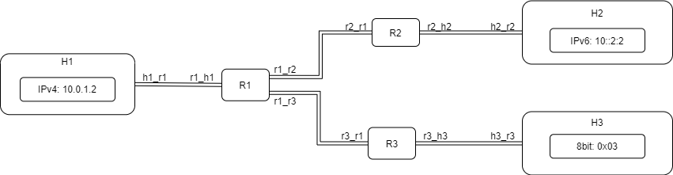
Topology Setup - NeST

Slide 14
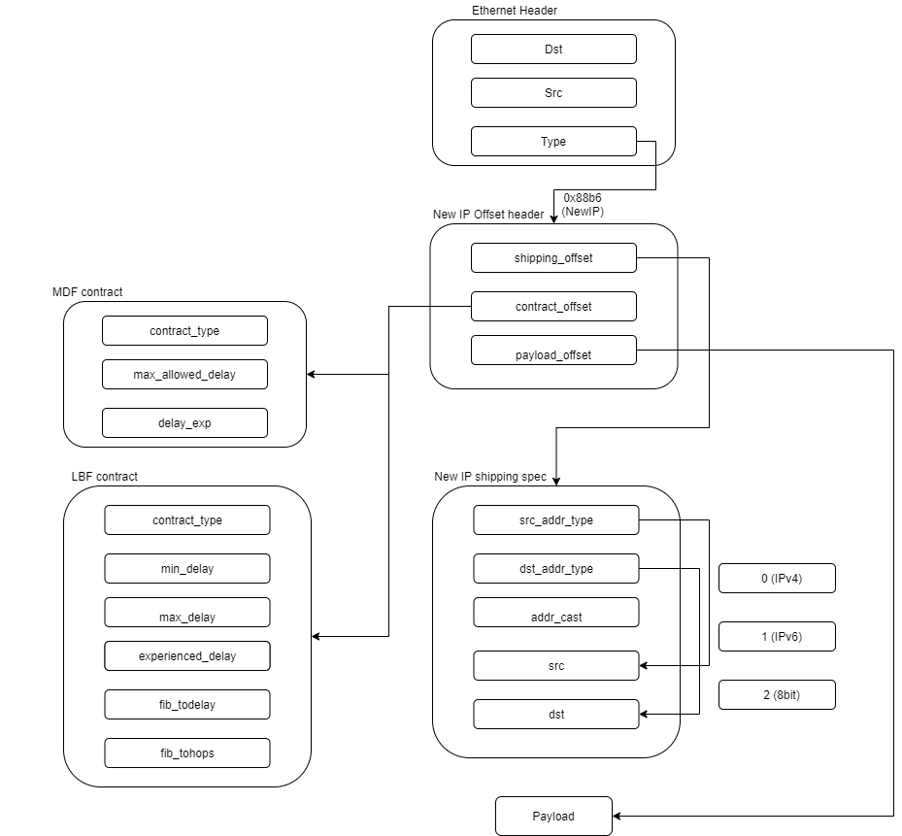
New IP Packet

Slide 15
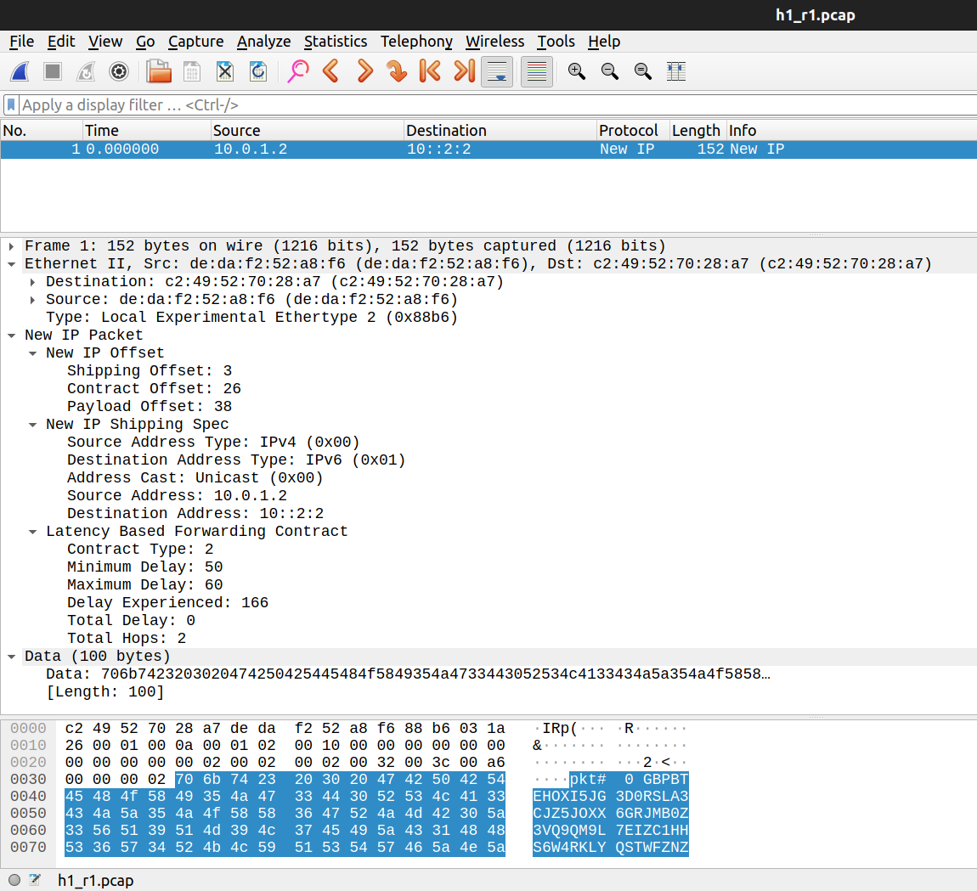
New IP Packet in Wireshark

Slide 16
API for Crafting a New IP packet
sender_obj = Sender()
sender_obj.make_packet(src_addr_type="ipv4", src_addr="10.0.1.2", dst_addr_type="ipv6", dst_addr="10::2:2",content="ipv4 to ipv6 from h1 to h2 more latency")
lbf_contract = LatencyBasedForwarding(min_delay = 500, max_delay = 800, fib_todelay = 0, fib_tohops = 3)
sender_obj.set_contract ([lbf_contract])
sender_obj.send_packet(iface='h1_r1', show_pkt=True)

Slide 17
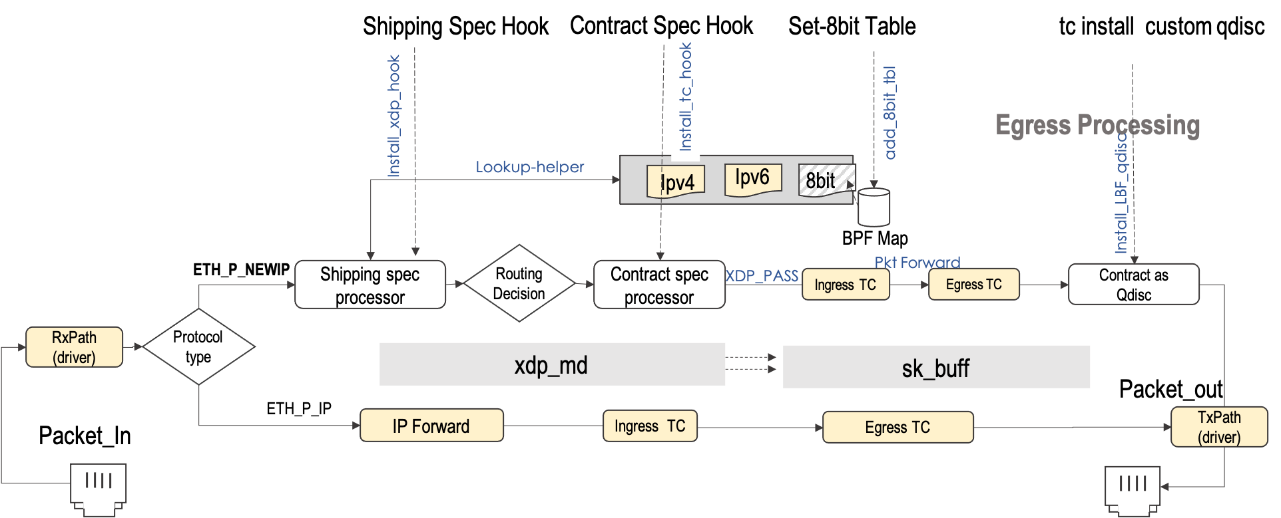
New IP Packet processing

Slide 18
References
XDP
https://www.iovisor.org/technology/xdp
https://github.com/xdp-project/xdp-tutorial
NeST
https://nest.nitk.ac.in/docs/
Scapy
https://scapy.readthedocs.io/en/latest/usage.html
LBF
High-Precision Latency Forwarding over Packet-Programmable Networks : https://ieeexplore.ieee.org/document/9110431

